Slide 1
Building Storm Trident Topologies
Douglas Moore
Principal Consultant & Architect
August 2013
Notes:
Thanks for your time today.
Excited to share how Think Big Analytics can help you make big data come alive to allow you to accelerate your time to value.
We founded the company after Ron Bodkin’s work at Quantcast, one of the pioneers in leveraging Hadoop and data science technologies to build a new $100M business in advertising. Ron got together again with Rick Farnell who saw the opportunity to monetize the pace of open source software adoption by both startups and enterprises while at Sun Microsystems leading Sun’s move to a Software as a service model on Amazon and played a key role in one of the largest open source software acquisitions in the technology industry. Together with Katie Bodkin our 3rd Founder we built the vision for what is now Think Big Analytics. Today we’re helping innovative companies take advantage of the power of big data.

Slide 2
Boston Storm Meetup 2013-08-20 Agenda
Purpose:
Familiar with Trident capabilities
Get you up and coding Trident & DRPC
The path:
Background & Assumptions
Think Big, Storm,…
What is Trident
The code
Take away

Slide 3




Leading Provider
Data Science and Engineering Services
Accelerating Your Time to Value using Big Data
IMAGINE
ILLUMINATE
IMPLEMENT
Strategy and Roadmap
Training and Education
Hands-On Data Science and Data Engineering
Notes:
That is what we do.
Think Big Analytics provides data science and engineering services that create value from Big Data
We help you IMAGINE your possibilities for big data and identify a plan for profitable projects
We ILLUMINATE your team through training and education on the latest in big data technologies
We then help you IMPLEMENT your analytics plan with hands-on data scientists and engineers who rapidly build data solutions to deliver value.

Slide 4





















Accelerating Value for Industry Leaders
Blue Chip Customers
Netapp
Predictive IT Support
Reduced Critical Customer Support Tickets
Acxiom
Combine Offline Data with Online Data Analytics
New Revenues for services with Global Customers
HSBC
Customer Risk Analysis
Decreased Time for Identifying Non Optimal Client Interaction by Weeks
Notes:
Think Big has helped companies of all sizes – from SMBs to the Fortune 50 – generate value from big data.
What we know for sure is this – the technology is so new that all organizations are seeking support and as you can see here, many of them come to Think Big.
So let’s look at the landscape…

Slide 5
Storm Concepts

Slide 6
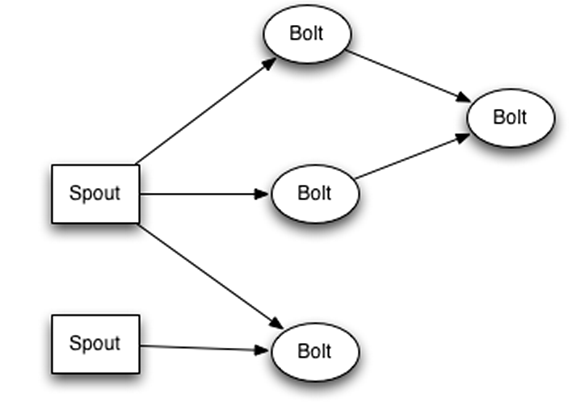
Storm Overview
DAG Processing of never ending streams of data
Open Sourced: https://github.com/nathanmarz/storm/wiki
Used at Twitter plus > 24 other companies
Reliable - At Least Once semantics
Think MapReduce for data streams
Java / Clojure based
Bolts in Java and ‘Shell Bolts’
Not a queue, but usually reads from a queue.
Related:
S4, CEP, InfoStreams, HStreaming,…
Compromises
Static topologies & cluster sizing – Avoid messy dynamic rebalancing
Nimbus – SPOF
Strong Community Support, commercial support from InfoChimps
Notes:
At Least Once Semantics means the possibility of duplicates
This requires a read-repair process

Slide 7
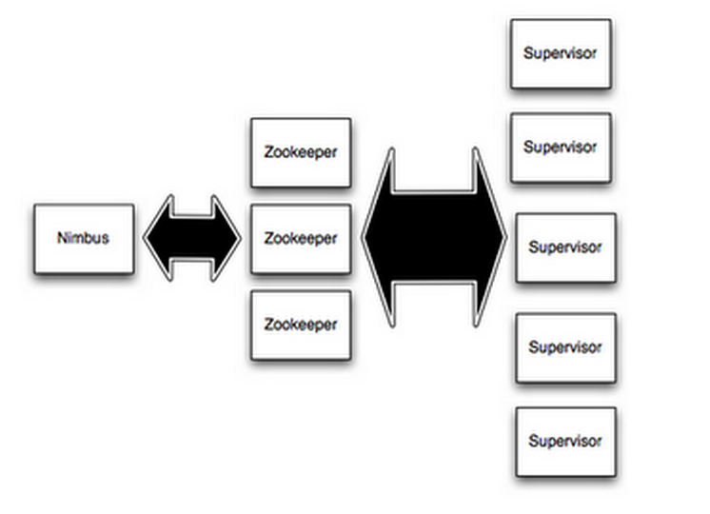
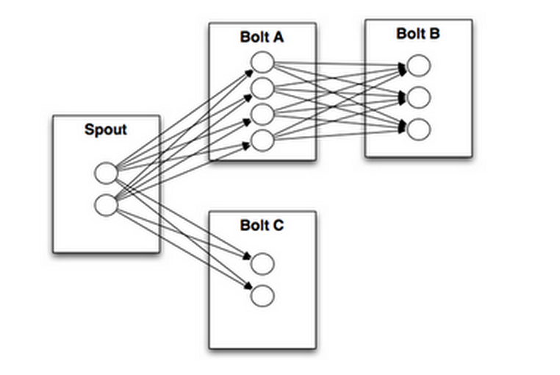
Storm Concepts Review
Cluster
Supervisor
Worker
Topology
Streams
Spout
Bolt
Tuple
Stream Groupings
Shuffle, Field
Trident
DRPC
Notes:
Streams – unbounded sequence of tuples
Tuple – Named list of Values
Stream Groupings – shuffleGrouping, fieldsGrouping

Slide 8
Where do we use Storm / Trident?

Slide 9
Storm & Big Data Patterns

Slide 10
Analytics Architecture – Speed layer

Slide 11
Why?

Slide 12
Why Real-time?
Better end-user experience
Lower Latency
Need to catch fast moving events
Trending topics
Fraud
System updates

Slide 13
Why Storm?
Needed better way to manage queue readers and logic pipeline
Much better than roll your own
Reliable (Message guarantees, fault tolerant)
Multi-node scaling (1MM messages / 1 node / second)
It works
For more reasons: https://github.com/nathanmarz/storm/wiki/Rationale
Scalable low latency ETL
Reliable Cron

Slide 14

Why Trident?
When you need:
Once and Only Once Semantics – “One and Done”
Transactional Topologies
Convenient Abstractions for Persistent Aggregates
Concepts familiar to Pig & Cascading users
Joins, Grouping, Aggregation, Functions, Filters
Stateful Incremental processing on top of data stores
Examples & Use Cases
Processing a batch upload of invoices
Unpacking an archive of log events
Windowed moving average
Trending topics
Notes:
Once and only Once semantics for Trident vs. Storm’s at-least-once semantics.

Slide 15
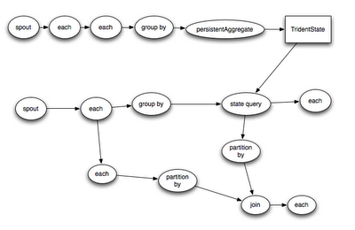
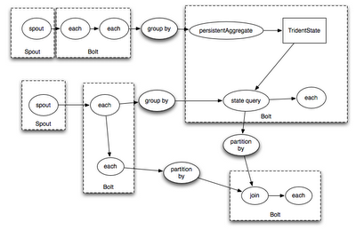
What is Trident exactly?
Trident is
Abstraction on top of Storm Infrastructure
Topology
Divided into streams
Optimized
DRPC compatible
Added to Storm 0.8.0 – Aug 2012
Trident is not
Compatible with Storm topologies, bolts and spouts
Source: https://blog.twitter.com/2012/trident-high-level-abstraction-realtime-computation
Notes:
Trident leverages Storm Nimbus, Supervisors, workers executors etc.
Trident does

Slide 16
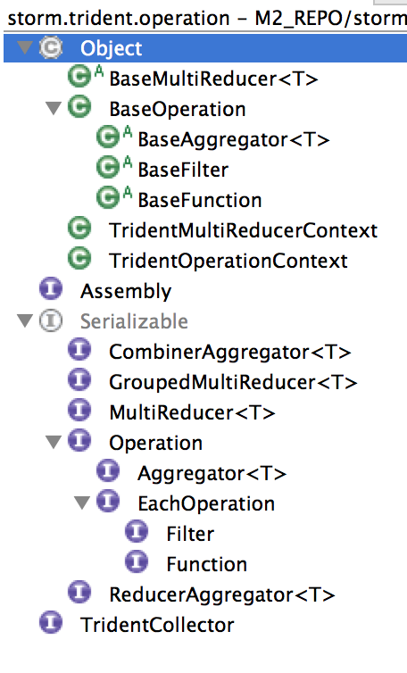
Trident operations
Filters
Functions
Aggregators
Reducers
Notes:
Filters – keep or not
Functions – Modify output
Aggregators (Sum(), Count(), StockAggregator)
Reducers

Slide 17
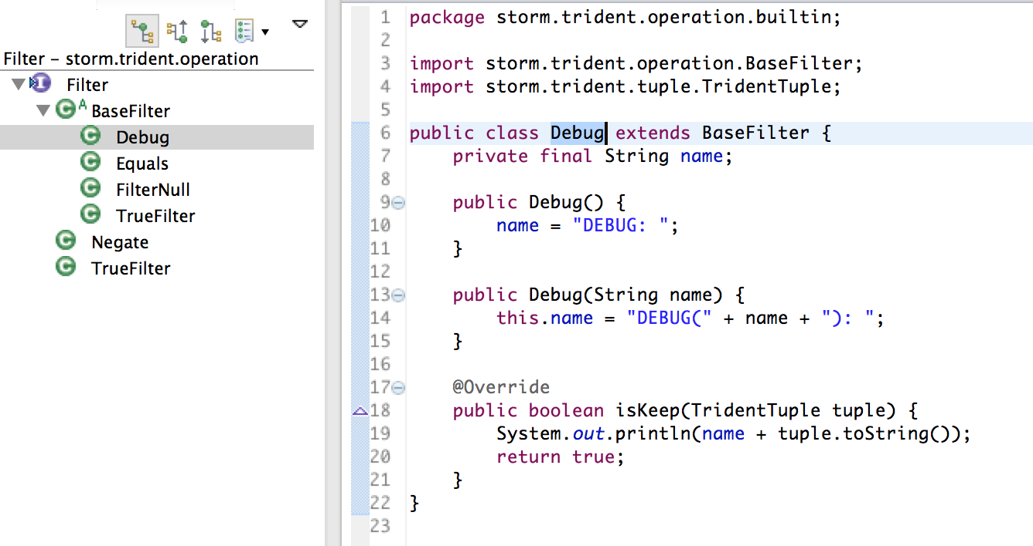
Filters

Slide 18
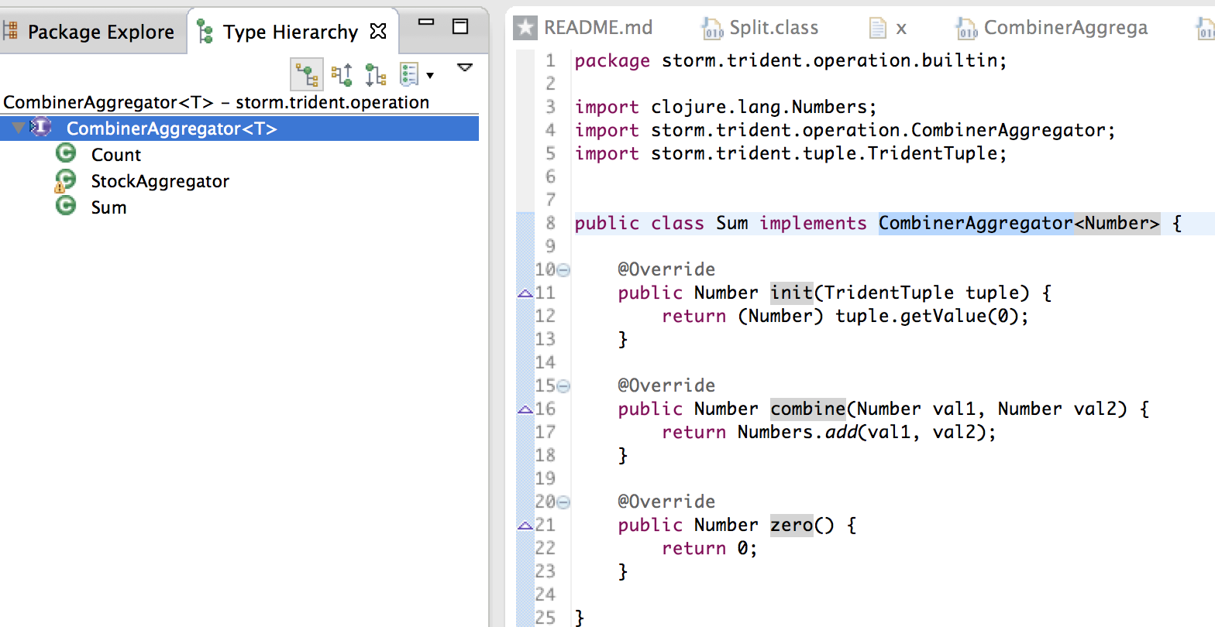
Aggregators

Slide 19
Show me the running code!
Simple Trident Topology + DRPC
Custom Trident CombinerAggregator

Slide 20
Take away
Trident isn’t too hard
DRPC is easy
Great for aggregates and much more
Good if you need ‘one and done’

Slide 21
Questions?
Contact:
douglas.moore at thinkbiganalytics dot com
www.thinkbiganalytics.com
Github:
https://github.com/dmoore247/storm-trident-tutorial
Yes we are hiring!!
- Consulting Skills
- Never get bored, lots of new projects
- Work at home & client sites

Slide 22
Thank you!

